Slide 1
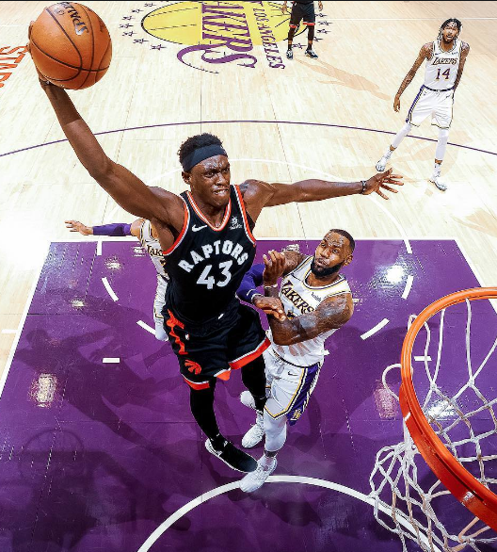
Spicy P
What makes you jump HIGH?

Slide 2

Andre Degrasse
What makes you run FAST?

Slide 3
Third Law Definition
Newton’s Third Law States:
“For every action force there is an equal and opposite reaction force.”
But what does this mean?

Slide 4
Demo
Consider these two dynamics carts with a spring in the middle…
A
B
Action Force
Reaction Force
F_{BonA}
F_{AonB}
F_{BonA} = -F_{AonB}

Slide 5
Sample Problem
A 10Kg
B 20Kg
What happens if the masses of the cart are not equal?
Is the Action / Reaction Force unequal?
Why is the acceleration unequal?

Slide 6

Question #1
If you push on a box, will it push back?
Yes – Newton’s Third Law

Slide 7
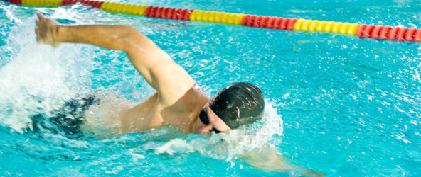
Third Law Practice Worksheet
A person swims forward in water.
Action Force
Swimmer pushes on the water.
Reaction Force
Water pushes back. The swimmer moves forward.

Slide 8
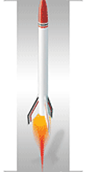
Rocket Thrust
How do rockets work?
Note: The full name is actually “Reaction Rocket”

Slide 9

Rocket Thrust
In space there is nothing to push, pull, or scoop.
So how do rockets work?
Fuel is burnt and violently ejected out of the rocket engine.
The ejected mass (fuel) exerts a reaction force on the rocket.

Slide 10
Rocket Thrust
Reaction Force
Ejected matter pushes back on the rocket accelerating the rocket forward.
Action Force
Rocket engine ejects matter at high velocity.

Slide 12
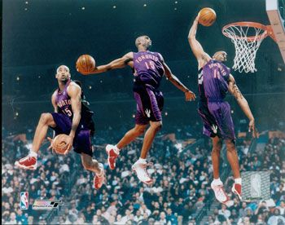
Vince Carter
What makes you jump HIGH?

